Slide 1
Introduction of Web Programming

Slide 2
Part 1. Introduction to Web Programming Languages
Frontend
HTML, CSS, Javascript
Backend
PHP, MySQL

Slide 3
1.1 HTML5, CSS3, JavaScript, Canvas and jQuery
HTML5
HTML (HyperText Markup Language) is a special type of computer language called a markup language designed to specify the content and structure of web pages (also called documents) in a portable manner.
HTML5, is the emerging version of HTML.
HTML enables you to create content that will render appropriately across the extraordinary range of devices connected to the Internet—including smartphones, tablet computers, notebook computers, desktop computers, special-purpose devices such as large-screen displays at concert arenas and sports stadiums, and more.

Slide 4
1.1 HTML5, CSS3, JavaScript, Canvas and jQuery
Cascading Style Sheets (CSS)
Although HTML5 provides some capabilities for controlling a document’s presentation, it’s better not to mix presentation with content.
Cascading Style Sheets (CSS) are used to specify the presentation, or styling, of elements on a web page (e.g., fonts, spacing, sizes, colors, positioning).
CSS was designed to style portable web pages independently of their content and structure.
By separating page styling from page content and structure, you can easily change the look and feel of the pages on an entire website, or a portion of a website, simply by swapping out one style sheet for another.
CSS3 is the current version of CSS under development.

Slide 5
1.1 HTML5, CSS3, JavaScript, Canvas and jQuery
JavaScript
JavaScript helps you build dynamic web pages (i.e., pages that can be modified “on the fly” in response to events, such as user input, time changes and more) and computer applications.
It enables you to do the client-side programming of web applications.
JavaScript was created by Netscape.
Both Netscape and Microsoft have been instrumental in the standardization of JavaScript by ECMA International (formerly the European Computer Manufacturers Association) as ECMAScript.
ECMAScript 5, the latest version of the standard, corresponds to the version of JavaScript we use in the book.
JavaScript is a portable scripting language. Programs written in JavaScript can run in web browsers across a wide range of devices.

Slide 6
1.1 HTML5, CSS3, JavaScript, Canvas and jQuery
Support for HTML5, CSS3 and JavaScript features varies by browser.
The HTML5 Test website (http://html5test.com/) scores each browser based on its support for the latest features of these evolving standards.
Figure 1.5 lists the five desktop browsers we use in reverse order of their HTML5 Test scores from most compliant to least compliant at the time of this writing.
You can also check sites such as http://caniuse.com/ for a list of features covered by each browser.

Slide 7
1.1 HTML5, CSS3, JavaScript, Canvas and jQuery
jQuery
jQuery (jQuery.org) is currently the most popular of hundreds of JavaScript libraries.
www.activoinc.com/blog/2008/11/03/jquery-emerges-as-most-popular-javascript-library-for-web-development/.
jQuery simplifies JavaScript programming by making it easier to manipulate a web page’s elements and interact with servers in a portable manner across various web browsers.
It provides a library of custom graphical user interface (GUI) controls (beyond the basic GUI controls provided by HTML5) that can be used to enhance the look and feel of your web pages.
Canvas
The HTML <canvas> element is used to draw graphics, on the fly, via JavaScript.
https://www.w3schools.com/html/html5_canvas.asp

Slide 8
1.2 Backend Languages
PHP
MySQL

Slide 9
1.3 Web Browsers
Web Browsers and Web-Browser Portability
Ensuring a consistent look and feel on client-side browsers is one of the great challenges of developing web-based applications.
Currently, a standard does not exist to which software vendors must adhere when creating web browsers.
Although browsers share a common set of features, each browser might render pages differently.

Slide 10
1.3 Web Browsers
Browsers are available in many versions and on many different platforms (Microsoft Windows, Apple Macintosh, Linux, UNIX, etc.).
Vendors add features to each new version that sometimes result in cross-platform incompatibility issues.
It’s difficult to develop web pages that render correctly on all versions of each browser.
All of the code examples in the book were tested in the five most popular desktop browsers and the two most popular mobile browsers (Fig. 1.5).

Slide 11
Web Browsers
https://en.wikipedia.org/wiki/Web_browser
What is the function of a web browser?

Slide 12
Part 2. Introduction to History of the Internet
1960
1970
1980

Slide 13
1.5 Evolution of the Internet and World Wide Web
Time: 1960s
People: ARPA (the Advanced Research Projects Agency)
Location: USA
Things happened: They created ARPANET, with packet switching

Slide 14
1.5 Evolution of the Internet and World Wide Web
ARPANET
The Internet—a global network of computers—was made possible by the convergence of computing and communications technologies.
In the late 1960s, ARPA (the Advanced Research Projects Agency) rolled out blueprints for networking the main computer systems of about a dozen ARPA-funded universities and research institutions.
They were to be connected with communications lines operating at a then-stunning 56 Kbps (i.e., 56,000 bits per second)—this at a time when most people (of the few who could) were connecting over telephone lines to computers at a rate of 110 bits per second.

Slide 15
1.5 Evolution of the Internet and World Wide Web
A bit (short for “binary digit”) is the smallest data item in a computer; it can assume the value 0 or 1.
ARPA proceeded to implement the ARPANET, which eventually evolved into today’s Internet.
Rather than enabling researchers to share each other’s computers, it rapidly became clear that communicating quickly and easily via electronic mail was the key early benefit of the ARPANET.
This is true even today on the Internet, which facilitates communications of all kinds among the world’s Internet users.
Link:
What is the Internet?
https://www.youtube.com/watch?v=Dxcc6ycZ73M&list=PLzdnOPI1iJNfMRZm5DDxco3UdsFegvuB7
Wires, cables, wifi
https://www.youtube.com/watch?v=ZhEf7e4kopM&list=PLzdnOPI1iJNfMRZm5DDxco3UdsFegvuB7&index=2

Slide 16
1.5 Evolution of the Internet and World Wide Web
Packet Switching
One of the primary goals for ARPANET was to allow multiple users to send and receive information simultaneously over the same communications paths (e.g., phone lines).
The network operated with a technique called packet switching, in which digital data was sent in small bundles called packets.
The packets contained address, error-control and sequencing information.
The address information allowed packets to be routed to their destinations.

Slide 17
1.5 Evolution of the Internet and World Wide Web
The sequencing information helped in reassembling the packets—which, because of complex routing mechanisms, could actually arrive out of order—into their original order for presentation to the recipient.
Packets from different senders were intermixed on the same lines to efficiently use the available bandwidth.
The network was designed to operate without centralized control.
If a portion of the network failed, the remaining working portions would still route packets from senders to receivers over alternative paths for reliability.
Link:
The Internet: Packets, Routing& Reliaility https://www.youtube.com/watch?v=AYdF7b3nMto&index=4&list=PLzdnOPI1iJNfMRZm5DDxco3UdsFegvuB7

Slide 18
1.5 Evolution of the Internet and World Wide Web
Time: 1970s
People: ARPA (the Advanced Research Projects Agency)
Location: USA
Things happened: They created TCP and IP

Slide 19
1.5 Evolution of the Internet and World Wide Web
Packets & Routing & Reliability

Slide 20
1.5 Evolution of the Internet and World Wide Web
TCP/IP
The protocol (i.e., set of rules) for communicating over the ARPANET became known as TCP—the Transmission Control Protocol.
TCP ensured that messages were properly routed from sender to receiver and that they arrived intact.
As the Internet evolved, organizations worldwide were implementing their own networks for both intraorganization (i.e., within the organization) and interorganization (i.e., between organizations) communications.
One challenge was to get these different networks to communicate.

Slide 21
1.5 Evolution of the Internet and World Wide Web
ARPA accomplished this with the development of IP—the Internet Protocol, truly creating a network of networks, the current architecture of the Internet.
The combined set of protocols is now commonly called TCP/IP.
Each computer on the Internet has a unique IP address.
The current IP standard, Internet Protocol version 4 (IPv4), has been in use since 1984 and will soon run out of possible addresses.
IPv6 is just starting to be deployed. It features enhanced security and a new addressing scheme, hugely expanding the number of IP addresses available so that we will not run out of IP addresses in the forseeable future.
Link:
https://en.wikipedia.org/wiki/IPv6
The Internet: IP Addresses & DNS
https://www.youtube.com/watch?v=5o8CwafCxnU&list=PLzdnOPI1iJNfMRZm5DDxco3UdsFegvuB7&index=3

Slide 22
1.5 Evolution of the Internet and World Wide Web
Explosive Growth
Initially, Internet use was limited to universities and research institutions; then the military began using it intensively.
Eventually, the government decided to allow access to the Internet for commercial purposes.
Bandwidth (i.e., the information-carrying capacity) on the Internet’s is increasing rapidly as costs dramatically decline.

Slide 23
1.5 Evolution of the Internet and World Wide Web
Time: 1989
People: Tim Berners-Lee of CERN (the European Organization for Nuclear Research)
Location: Europe
Things happened: They created HTML and HTTP Protocal

Slide 24
1.5 Evolution of the Internet and World Wide Web
World Wide Web, HTML, HTTP
The World Wide Web allows computer users to execute web-based applications and to locate and view multimedia-based documents on almost any subject over the Internet.
In 1989, Tim Berners-Lee of CERN (the European Organization for Nuclear Research) began to develop a technology for sharing information via hyperlinked text documents.
Berners-Lee called his invention the HyperText Markup Language (HTML).
He also wrote communication protocols to form the backbone of his new information system, which he called the World Wide Web.
In particular, he wrote the Hypertext Transfer Protocol (HTTP)—a communications protocol used to send information over the web.
The URL (Uniform Resource Locator) specifies the address (i.e., location) of the web page displayed in the browser window.
Each web page on the Internet is associated with a unique URL.
URLs usually begin with http://.

Slide 25
1.5 Evolution of the Internet and World Wide Web
HTTPS
URLs of websites that handle private information, such as credit card numbers, often begin with https://, the abbreviation for Hypertext Transfer Protocol Secure (HTTPS).
HTTPS is the standard for transferring encrypted data on the web.
It combines HTTP with the Secure Sockets Layer (SSL) and the more recent Transport Layer Security (TLS) cryptographic schemes for securing communications and identification information over the web.
Link:
The Internet: HTTP & HTML
https://www.youtube.com/watch?v=kBXQZMmiA4s&list=PLzdnOPI1iJNfMRZm5DDxco3UdsFegvuB7&index=5

Slide 26
1.5 Evolution of the Internet and World Wide Web
Time: 1993
People: Marc Andreessen, whose team at the National Center for Supercomputing Applications (NCSA)
Location: USA
Things happened: They created Mosaic browser and Netscape

Slide 27
1.5 Evolution of the Internet and World Wide Web
Mosaic, Netscape, Emergence of Web 2.0
Web use exploded with the availability in 1993 of the Mosaic browser, which featured a user-friendly graphical interface.
Marc Andreessen, whose team at the National Center for Supercomputing Applications (NCSA) developed Mosaic, went on to found Netscape, the company that many people credit with igniting the explosive Internet economy of the late 1990s.
But the “dot com” economic bust brought hard times in the early 2000s.
The resurgence that began in 2004 or so has been named Web 2.0.

Slide 28
1.5 Evolution of the Internet and World Wide Web
Time: 2004
People: Many people
Location: Around the world
Things happened: The web afterwards are called web2.0

Slide 29
1.5 Evolution of the Internet and World Wide Web
Mosaic, Netscape, Emergence of Web 2.0
The resurgence that began in 2004 or so has been named Web 2.0.
https://wittycookie.wordpress.com/2012/06/04/what-are-the-major-differences-among-web-1-0-2-0-and-3-0/
https://www.youtube.com/watch?v=oE8n1gdhETo

Slide 30
1.5 Evolution of the Internet and World Wide Web
Time: Now
People: You
Location: Around the world in the future
Things happened: web 3.0

Slide 31
Part 3. Web Basics
IP and DNS
HTML and HTTP
URL, get and post

Slide 32
1.6 Web Basics IP and DNS
IP address, ISP, DNS, and Web Server
https://www.youtube.com/watch?v=5o8CwafCxnU&list=PLzdnOPI1iJNfMRZm5DDxco3UdsFegvuB7&index=3
IP address
https://en.wikipedia.org/wiki/IPv6
IP address numbers by location
IP address geolocator
http://www.nirsoft.net/countryip/index.html
https://www.iplocation.net/

Slide 33
1.6 Web Basics IP and DNS
ISP
Internet Service Provider
https://broadbandnow.com/Texas/Houston
https://en.wikipedia.org/wiki/Internet_service_provider

Slide 34
1.6 Web Basics IP and DNS
IP address, ISP, DNS and Web Server
https://www.youtube.com/watch?v=5o8CwafCxnU&list=PLzdnOPI1iJNfMRZm5DDxco3UdsFegvuB7&index=3
DNS
https://en.wikipedia.org/wiki/Domain_Name_System
https://www.verisign.com/en_US/website-presence/online/how-dns-works/index.xhtml
https://www.whatsmydns.net/dns

Slide 35
1.6 Web Basics IP and DNS
Web Server
Apache
http://www.wpbeginner.com/glossary/apache/
https://en.wikipedia.org/wiki/Apache_HTTP_Server
IIS Server
http://searchwindowsserver.techtarget.com/definition/IIS
https://hostway.com/blog/which-web-server-iis-vs-apache/

Slide 36
1.6 Web Basics IP and DNS
With the above several crucial roles in the Internet, what happens when we type http://... , or click on a hyperlink in the browser?

Slide 37
1.6 Web Basics HTTP and HTML
In its simplest form, a web page is nothing more than an HTML (HyperText Markup Language) document (with the extension .html or .htm) that describes to a web browser the document’s content and structure.
Hyperlinks
HTML documents normally contain hyperlinks, which, when clicked, load a specified web document.
Both images and text may be hyperlinked.
When the user clicks a hyperlink, a web server locates the requested web page and sends it to the user’s web browser.
Similarly, the user can type the address of a web page into the browser’s address field and press Enter to view the specified page.

Slide 38
1.6 Web Basics (cont.) HTTP and HTML
Hyperlinks can reference other web pages, e-mail addresses, files and more.
If a hyperlink’s URL is in the form mailto:emailAddress, clicking the link loads your default e-mail program and opens a message window addressed to the specified e-mail address.
If a hyperlink references a file that the browser is incapable of displaying, the browser prepares to download the file, and generally prompts the user for information about how the file should be stored.

Slide 39
1.6 Web Basics (cont.) HTTP and HTML
URIs and URLs
URIs (Uniform Resource Identifiers) identify resources on the Internet.
URIs that start with http:// are called URLs (Uniform Resource Locators).
Parts of a URL
A URL contains information that directs a browser to the resource that the user wishes to access.
Web servers make such resources available to web clients.
Popular web servers include Apache’s HTTP Server and Microsoft’s Internet Information Services (IIS).

Slide 40
1.6 Web Basics (cont.) HTTP and HTML
Let’s examine the components of the URL
http://www.deitel.com/books/downloads.html
The text http:// indicates that the HyperText Transfer Protocol (HTTP) should be used to obtain the resource.
Next in the URL is the server’s fully qualified hostname (for example, www.deitel.com)—the name of the web-server computer on which the resource resides.
This computer is referred to as the host, because it houses and maintains resources.
The hostname www.deitel.com is translated into an IP (Internet Protocol) address—a numerical value that uniquely identifies the server on the Internet.
An Internet Domain Name System (DNS) server maintains a database of hostnames and their corresponding IP addresses and performs the translations automatically.

Slide 41
1.6 Web Basics (cont.) HTTP and HTML
The remainder of the URL (/books/downloads.html) specifies the resource’s location (/books) and name (downloads.html) on the web server.
The location could represent an actual directory on the web server’s file system. For security reasons, however, the location is typically a virtual directory.
The web server translates the virtual directory into a real location on the server, thus hiding the resource’s true location.
Making a Request and Receiving a Response
Figure 1.8 shows a web browser sending a request to a web server.

Slide 42
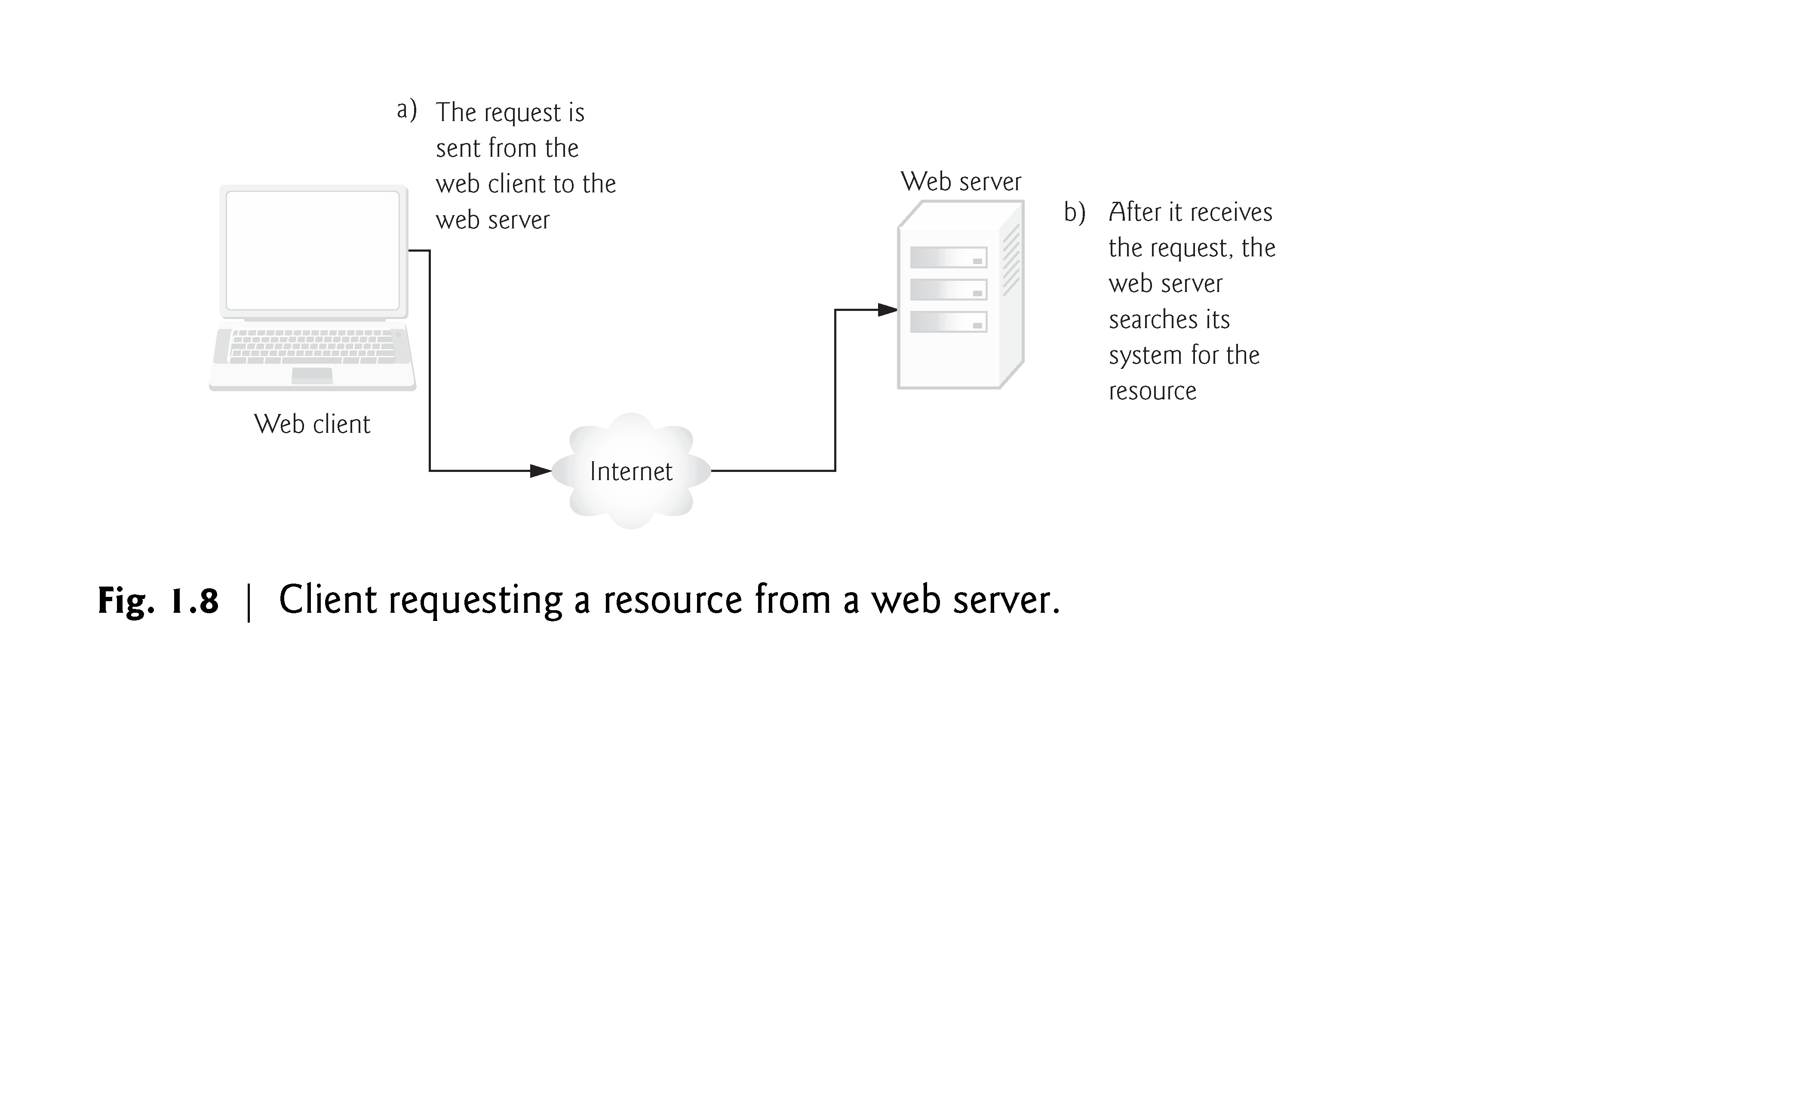

Slide 43
1.6 Web Basics (cont.)
In Fig. 1.8, the web browser sends an HTTP request to the server. The request (in its simplest form) is
GET /books/downloads.html HTTP/1.1
The word GET is an HTTP method indicating that the client wishes to obtain a resource from the server.
The remainder of the request provides the path name of the resource (e.g., an HTML5 document) and the protocol’s name and version number (HTTP/1.1).
The client’s request also contains some required and optional headers.
Figure 1.9 shows the web server responding to a request.

Slide 44
